Slide 1
Admin Project
11g New Feature
이승민 / 임재영

Slide 2
CONTENTS
CONTENTS
Real-time SQL Monitoring
1

Slide 3
Real-time SQL Monitoring
Real-time SQL Monitoring

Slide 4

ADMIN PROJECT
01.
Real-time SQL Monitoring
SGA
SQL
Real-time
SQL
Monitor
SQL
Shared
Pool
DB
Buffer
Cache
Redo log
Buffer
SQL
SQL
SQL
Database
SQL
C
D
R
SQL

Slide 5
ADMIN PROJECT
01.
Real-time SQL Monitoring
SQL Monitor Report 생성
Real-time
SQL Monitoring
SQL의 성능 모니터링
SQL의 다양한 메트릭 파악
Notes:
Metric : 누적 통계에서의 변화율

Slide 6
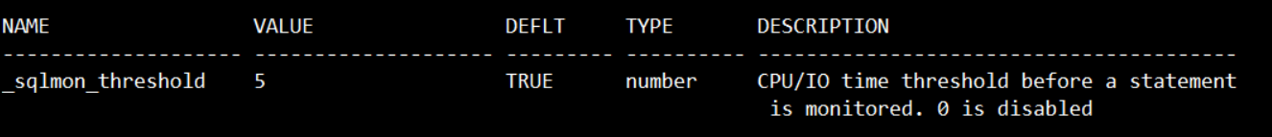
ADMIN PROJECT
01.
Real-time SQL Monitoring
col name for a20
col value for a20
col type for a10
col description for a40
select a.ksppinm name, b.ksppstvl value,b.ksppstdf deflt,
decode (a.ksppity, 1, 'boolean',
2, 'string',
3, 'number',
4, 'file',
a.ksppity) type,
a.ksppdesc description
from sys.x$ksppi a, sys.x$ksppcv b
where a.indx = b.indx and a.ksppinm like '\_%' escape '\'
and a.ksppinm like '%sqlmon_threshold%'
order by name;
모니터링하는 SQL 종류
실행 시간이 5초 이상인 모든 쿼리
_SQLMON_THRESHOLD 히든 파라미터로 조정
병렬처리로 수행된 쿼리

Slide 7
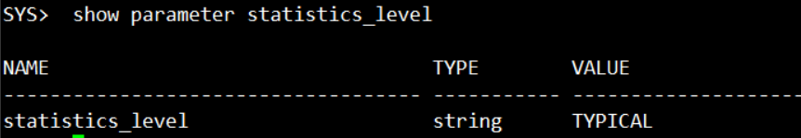
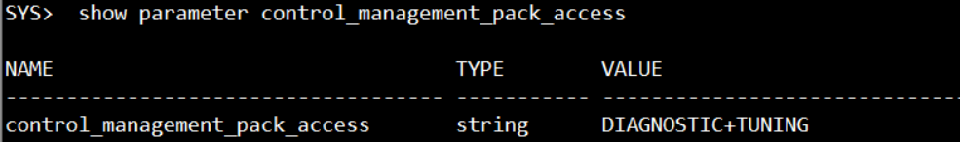
ADMIN PROJECT
01.
Real-time SQL Monitoring
초기 설정
STATISTICS_LEVEL 초기화 파라미터 값 지정
ALL 혹은 TYPICAL일 때만 가능하다.
CONTROL_MANAGEMENT_PACK_ACCESS 파라미터 값 지정
DIAGNOSTIC + TUNING 으로 설정되어 있어야 한다.

Slide 8
ADMIN PROJECT
01.
Real-time SQL Monitoring
추가 사항
MONITOR , NO_MONITOR라는 옵티마이저 힌트 제공
ex) SELECT /*+ MONITOR */ ~~~~~
V$SQL_MONITOR, V$SQL_PLAN_MONITOR 뷰 제공
위에 두 뷰로 모니터링 정보를 SQL로 검색할 수 있다.

Slide 9
예 제
예 제

Slide 10
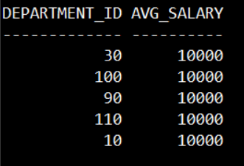
ADMIN PROJECT
01.
Real-time SQL Monitoring
REPORT 수동 생성
SELECT /*+ MONITOR */
A.DEPARTMENT_ID, ROUND(AVG(A.SALARY),2) AS AVG_SALARY
FROM hr.EMPLOYEES A
,hr.DEPARTMENTS B
WHERE A.DEPARTMENT_ID = B.DEPARTMENT_ID
AND B.LOCATION_ID = 1700
GROUP BY A.DEPARTMENT_ID;

Slide 11
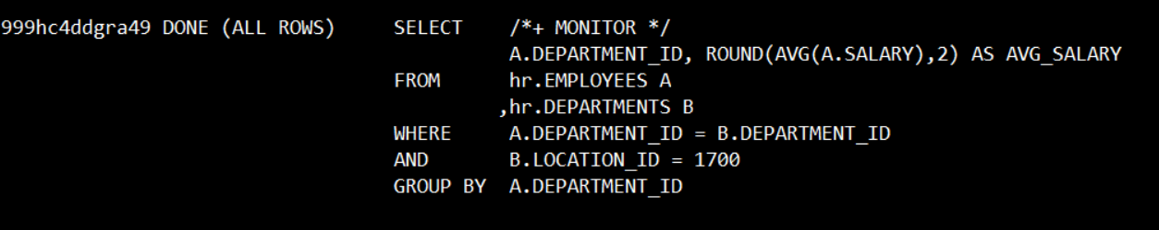
ADMIN PROJECT
01.
Real-time SQL Monitoring
REPORT 수동 생성
SELECT SQL_ID, STATUS, SQL_TEXT
FROM V$SQL_MONITOR
WHERE USERNAME = 'SYS';

Slide 12
ADMIN PROJECT
01.
Real-time SQL Monitoring
REPORT 수동 생성
SET LONG 1000000
SET LONGCHUNKSIZE 1000000
SET LINESIZE 1000
SET PAGESIZE 0
SET TRIM ON
SET TRIMSPOOL ON
SET ECHO OFF
SET FEEDBACK OFF

Slide 13
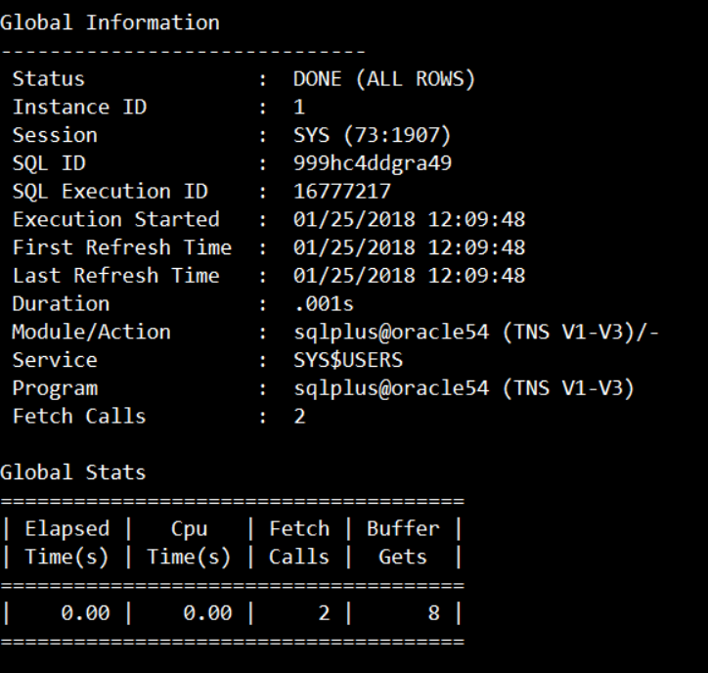
ADMIN PROJECT
01.
Real-time SQL Monitoring
REPORT 수동 생성
SELECT DBMS_SQLTUNE.report_sql_monitor(
sql_id => '999hc4ddgra49',
type => 'TEXT',
report_level => 'ALL') AS report
FROM dual;

Slide 14
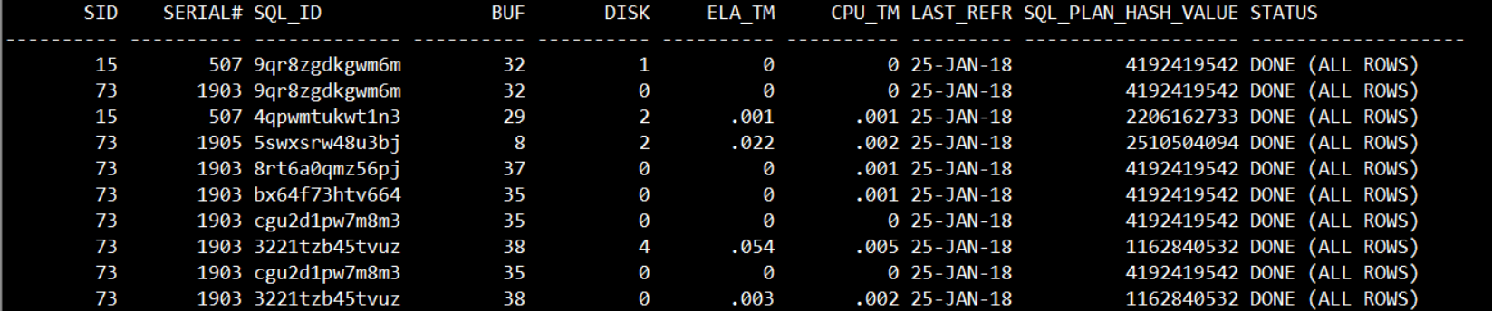
ADMIN PROJECT
01.
Real-time SQL Monitoring
V$SQL_MONITOR 검색
Set pagesize 100
SELECT sid, session_serial# SERIAL#, sql_id, round(buffer_gets) buf,
round(disk_reads) disk, round(elapsed_time/1000000,3) ELA_TM,
round(cpu_time/1000000,3) CPU_TM,
last_refresh_time,
sql_plan_hash_value,
status
FROM v$sql_monitor;

Slide 15
ADMIN PROJECT
01.
Real-time SQL Monitoring
EM 실습
Sqlplus moni/moni
DROP TABLE moni_test purge;
CREATE TABLE moni_test(c number, d varchar2(500));

Slide 16
ADMIN PROJECT
01.
Real-time SQL Monitoring
begin
for i in 1..200000 loop
insert into moni_test
values(1,'aaaaaaaaaaaaaaaaaaaaaaaaaaaaaaaaaaaaaaaaaaaaaaaaaa
aaaaaaaaaaaaaaaaaaaaaaaaaaaaaaaaaaaaaaaaaaaaaaaaaaaa');
end loop;
commit;
end;
/

Slide 17
ADMIN PROJECT
01.
Real-time SQL Monitoring
EM 실습
CREATE INDEX moni_test_c_indx ON moni_test(c);
SELECT count(*)
FROM moni_test t1, moni_test t2
WHERE t1.c = t2.c and t1.c=1;

Slide 18
ADMIN PROJECT
01.
Real-time SQL Monitoring
EM 실습
Session 하나 새로 켜주세요
EM 켜주세요
Sys계정으로 로그인후 Performance탭으로 이동

Slide 19
Thank you
Thank you

